Slide 1


Lesson 20 At the McDonnells’ in Scotland
UNIT 5

Slide 2
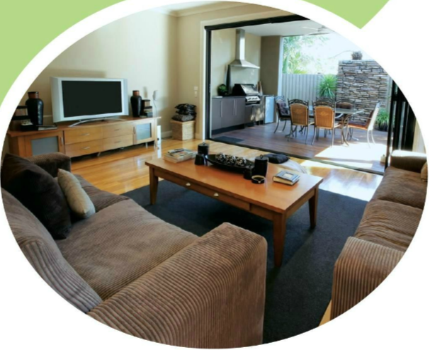
Look at the picture.
Write:
How many rooms in a house or flat can you name?
Which of them do you have in your house or flat?
Name all the furniture you can put in a living room.
Compare your answers with your friend.

Slide 3
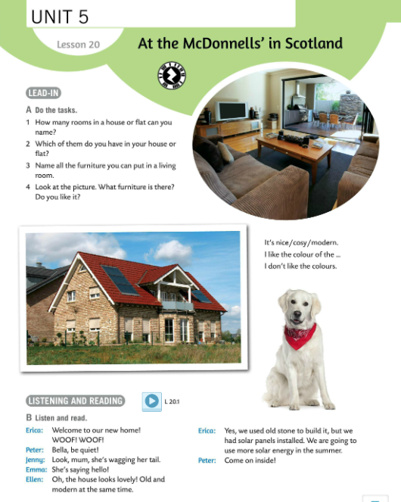
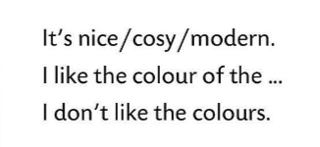
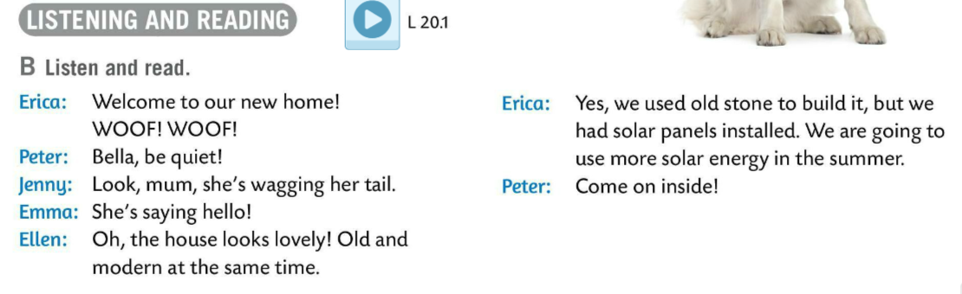

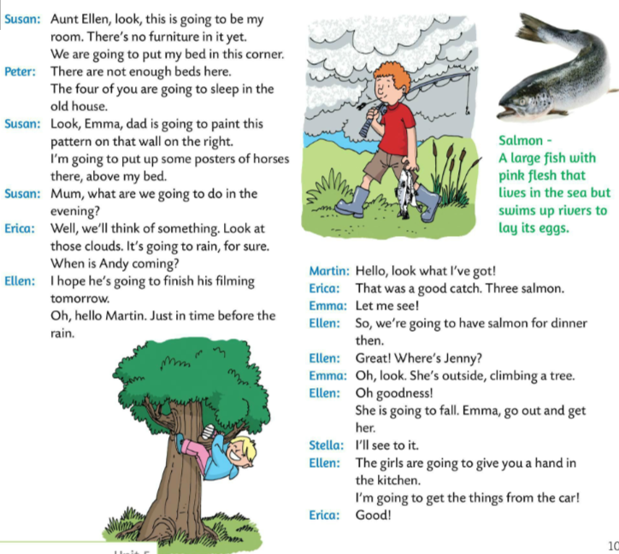
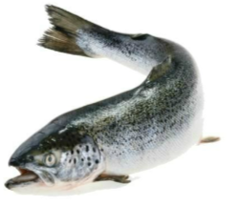
Describe the picture of the house in Task A. Use some of the following structures.
Listen and read the dialogue.
What kind of animal is salmon?
Where can you find that information?
Can you translate the word salmon into Croatian?
Have you ever tasted salmon?

Slide 4
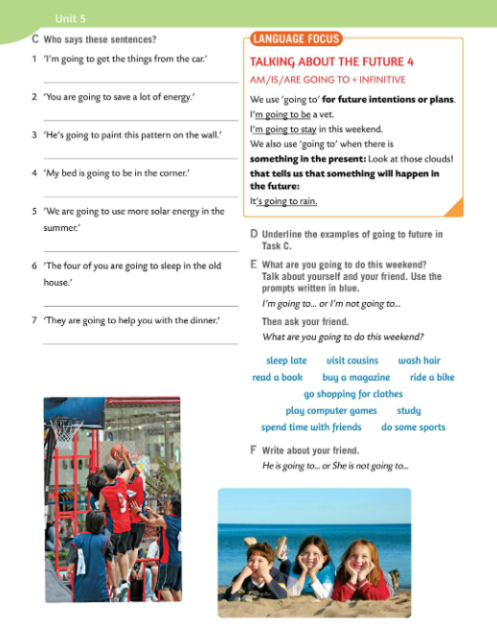
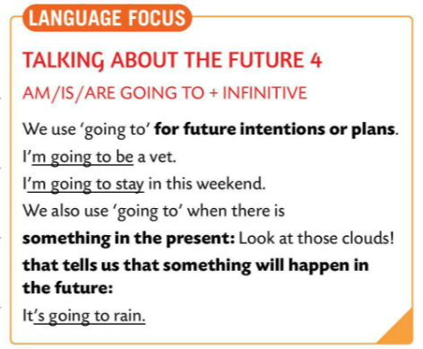
LANGUAGE FOCUS
We use GOING TO for expressing future intentions and plans.
Za buduće planove i namjere koristimo GOING TO.
subject + AM/IS/ARE + GOING TO +infinitive
I’m going to be a vet.
I’m going to stay at home this weekend.
We also use ‘GOING TO’ when there is something in the present: Look at those clouds! that tells us that something will happen in the future:
It’s going to rain.
GOING TO koristimo i pri predviđanjima temeljenima na dostupnim, trenutnim dokazima.

Slide 5
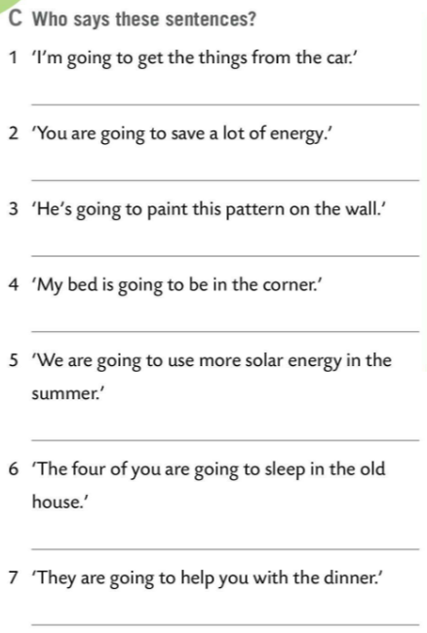
Who says sentences in Task C?
Check.
Ellen
Read the dialogue on the previous page in pairs.
Underline verbs in GOING TO future tense.
Check.
Ellen or Emma
Susan
Susan
Erica
Peter
Ellen

Slide 6
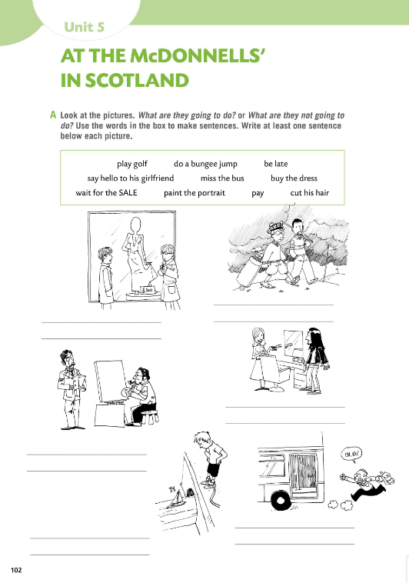
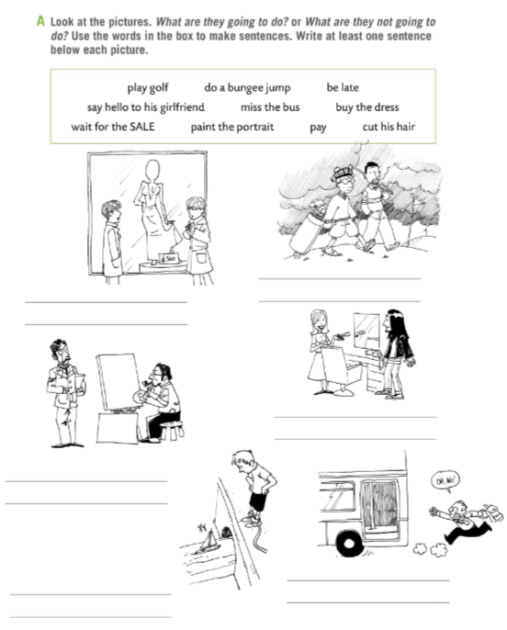

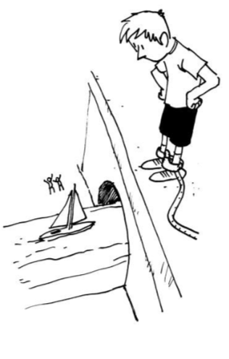
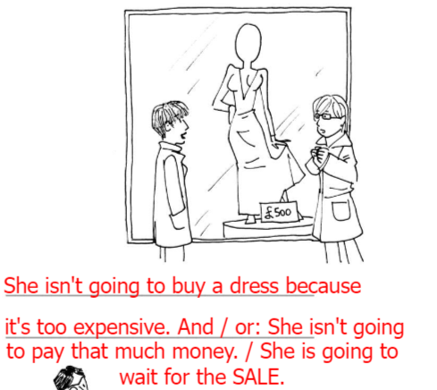
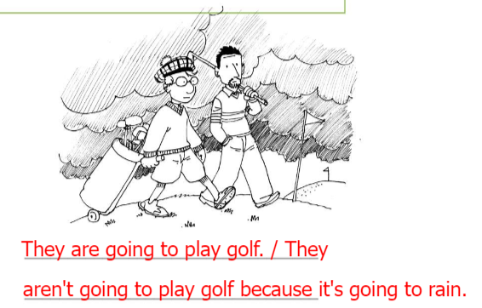
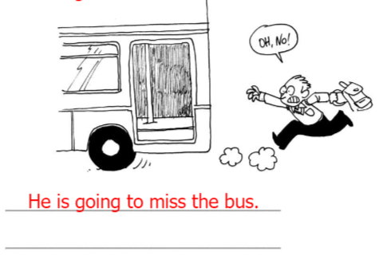
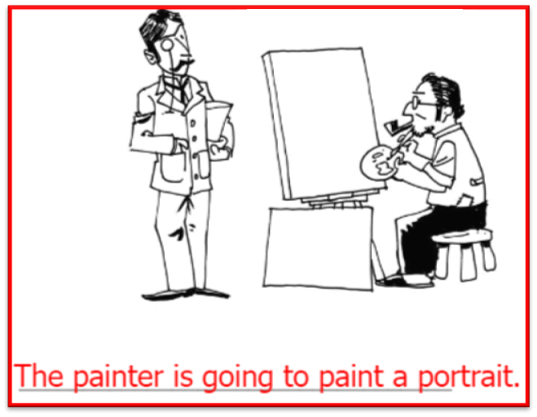
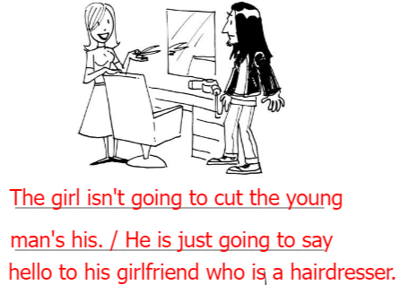
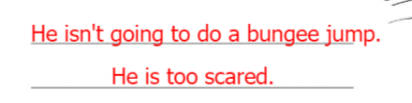
Workbook page 102.
Look at the pictures in Task A.
What are they going to do?
What are they not going to do?
Use the words in the box to make sentences. Write at least one sentence below each picture.
Check.

Slide 7
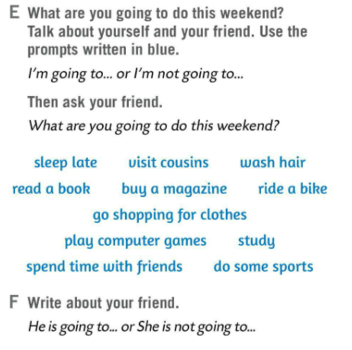
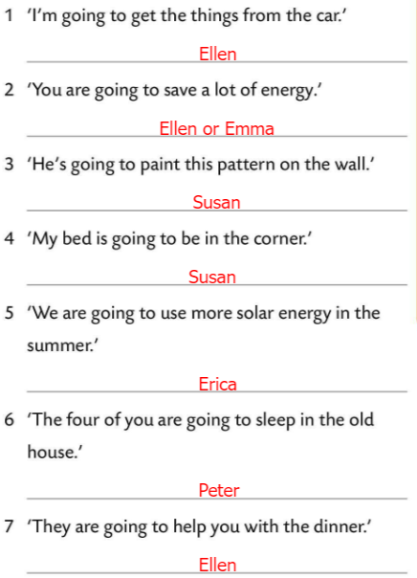
Underline the examples of going to future in Task C.
Check.
What are you going to do this weekend?
Talk about yourself and your friend.
Use the prompts written in blue.
Then ask your friend.
Write about your friend.

Slide 8
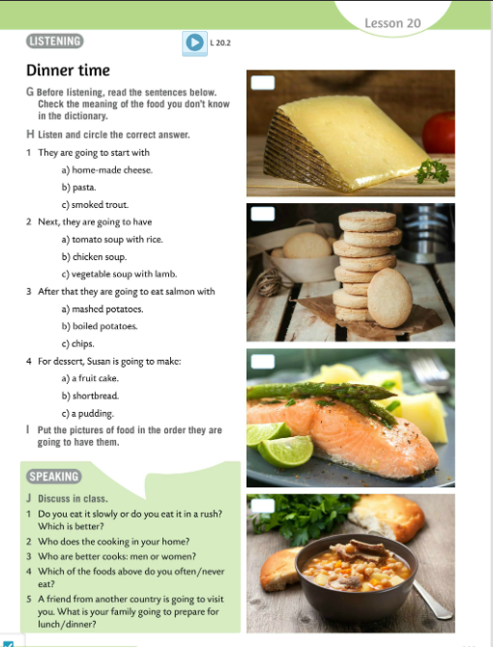
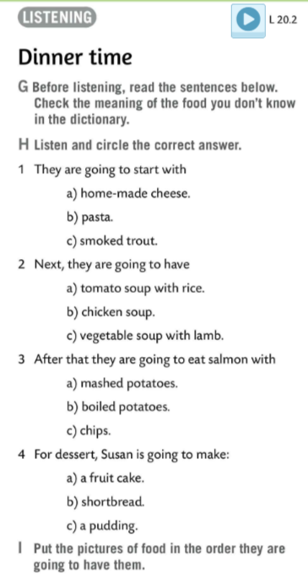
Read the sentences in Task H.
Translate:
home-made – domaći
pasta – tjestenina
smoked – dimljeni
trout – pastrva
lamb – janjetina
vegetable soup – povrtna juha
chicken soup – pileća juha
tomato soup – juha od rajčice
rice – riža
mashed potatoes – pire od krumpira
boiled potatoes – kuhani krumpir
chips – prženi krumpirići
shortbread – kolačić
a fruit cake – voćna torta

Slide 9
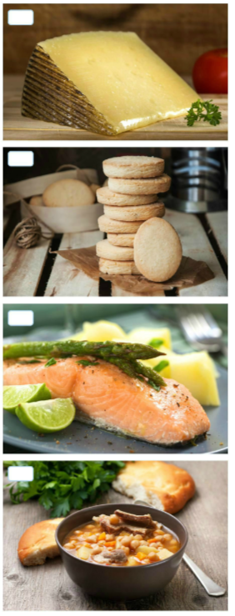
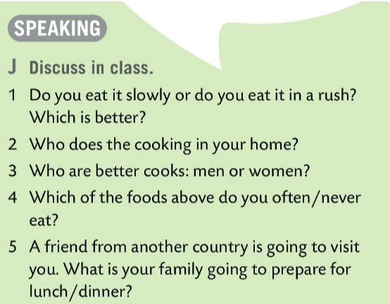
1
Listen to the recording and circle the correct answer in Task H.
4
Listen to the recording once again. Check.
3
Put the pictures of food in the order they are going to have them.
2
Read the questions in Task J and discuss in class.

Slide 10
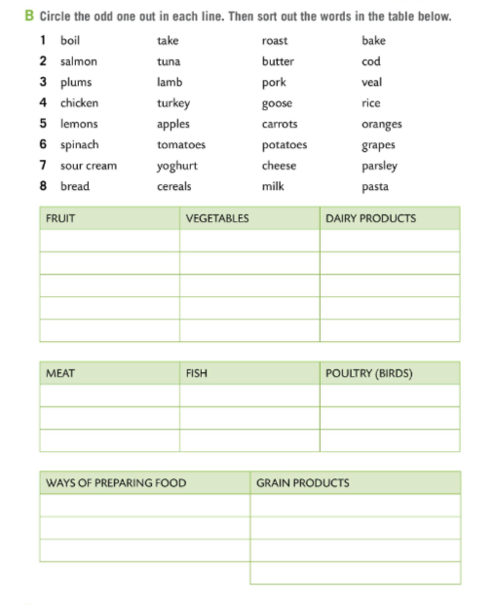
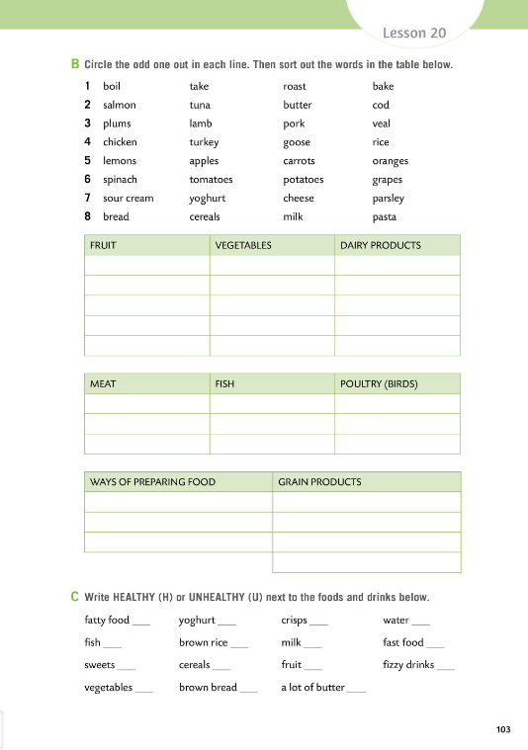
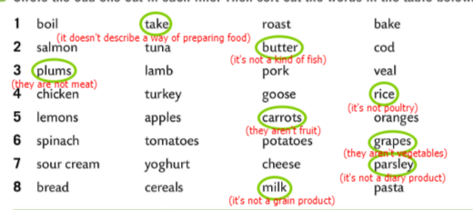
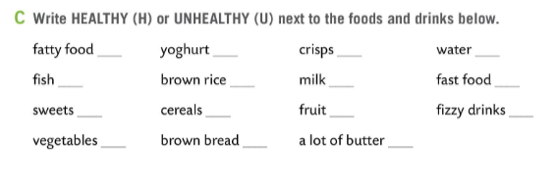
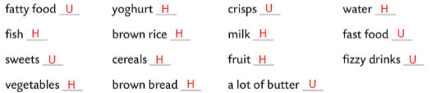
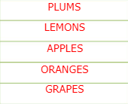
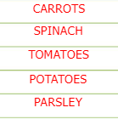
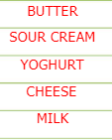




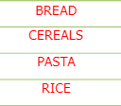
Workbook page 103.
Do Task B. Circle the odd on out.
Sort out the words in the table below.
Check.
Write HEALTHY (H) or UNHEALTHY (U).
Check.

Slide 11
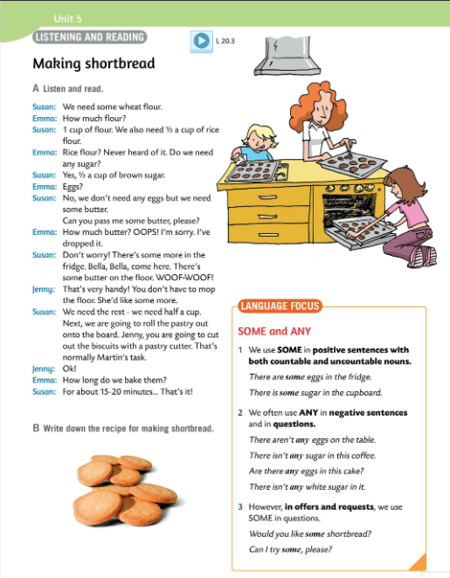
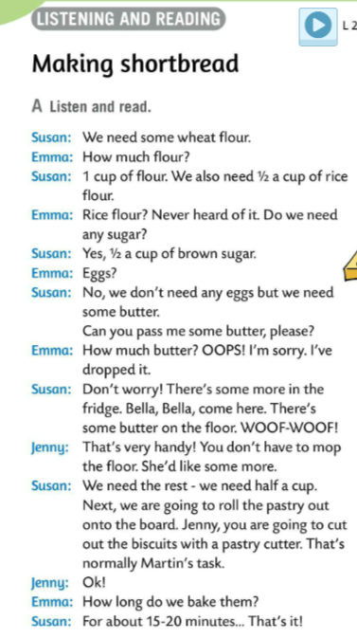
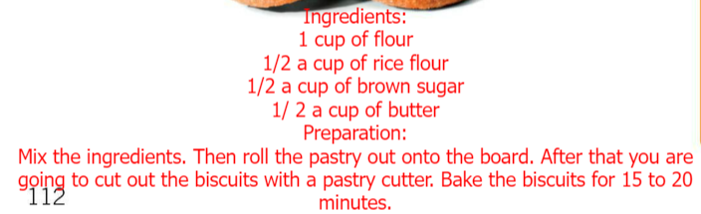
Listen and read the dialogue.
Listen to the dialogue again. Write down the recepie for making shortbread.
Check.

Slide 12
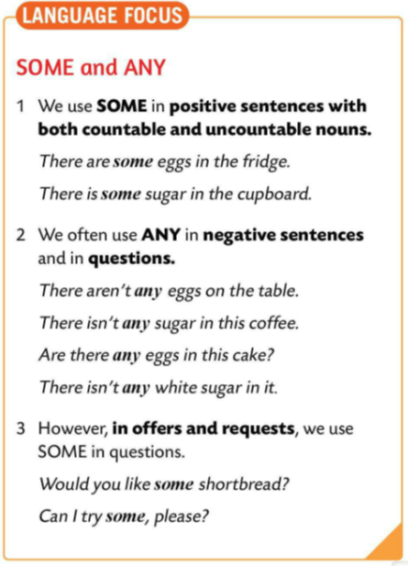
LANGUAGE BOX
We use SOME in positive sentences with both countable and uncountable nouns. / SOME koristimo u jesnim rečenicama s brojivim i nebrojivim imenicama.
There are SOME eggs in the fridge.
There is SOME sugar in the cupboard.
We often use ANY in NEGATIVE SENTENCES and in QUESTIONS. / ANY koristimo uz brojive i nebrojive imenice u množini, ali U UPITNIM I NIJEČNIM REČENICAMA.
There aren’t ANY eggs on the table.
There isn’t ANY sugar in this coffee.
Are there ANY eggs in this cake?
Is there ANY white sugar in it?
In OFFERS AND REQUESTS we use SOME. / Koristimo SOME u pitanjima ako se radi o PONUDI ili ZAHTJEVU (MOLBA).
Would you like SOME shortbread? (ponuda)
Can I try SOME, please? (zahtjev/molba)

Slide 13
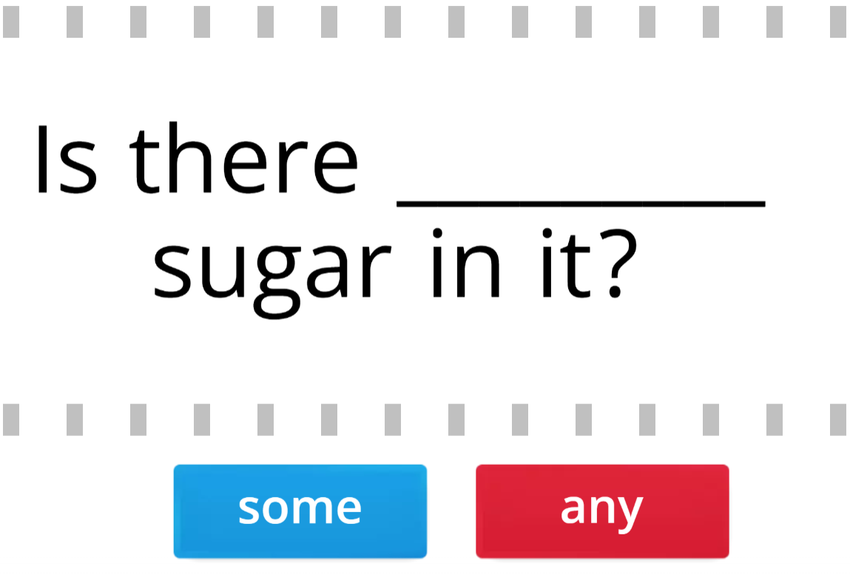
Learn and practise! Play this game in two teams.
https://wordwall.net/play/511/218/717

Slide 14
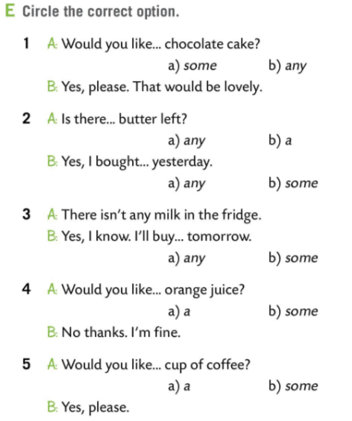
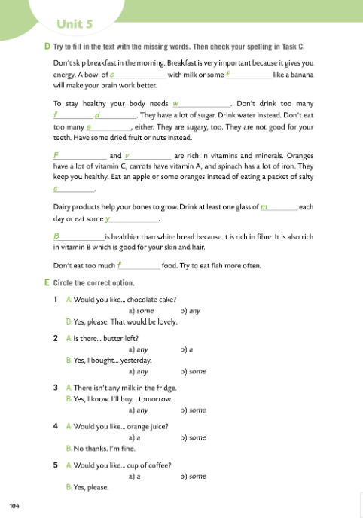
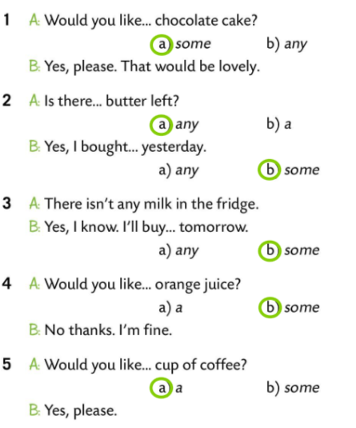
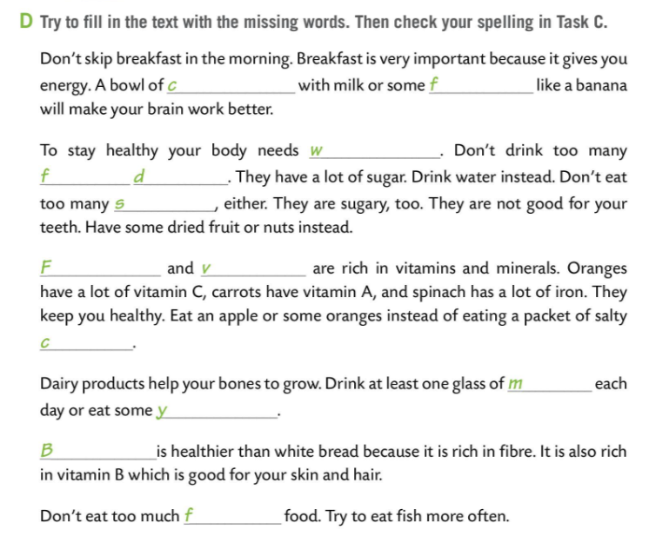
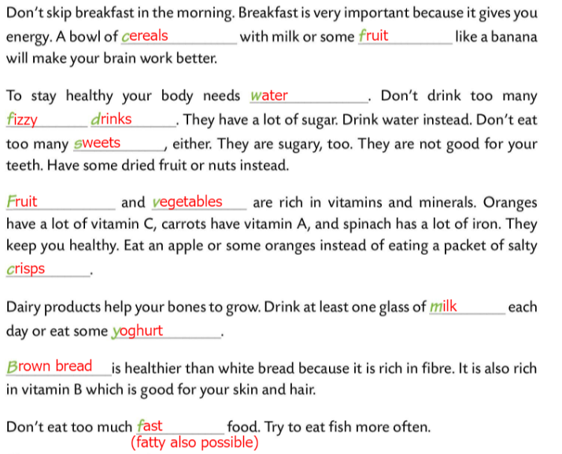
Workbook page 104.
Fill in the text with the missing words in Task D.
Check your spelling in Task C.
Check.
Circle the correct option in Task E.
Check.

Slide 15
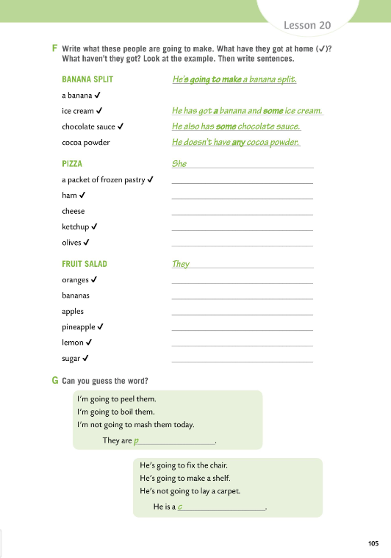
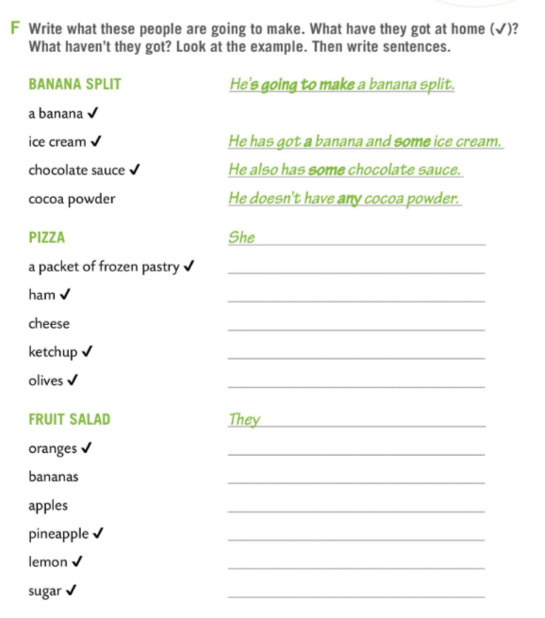
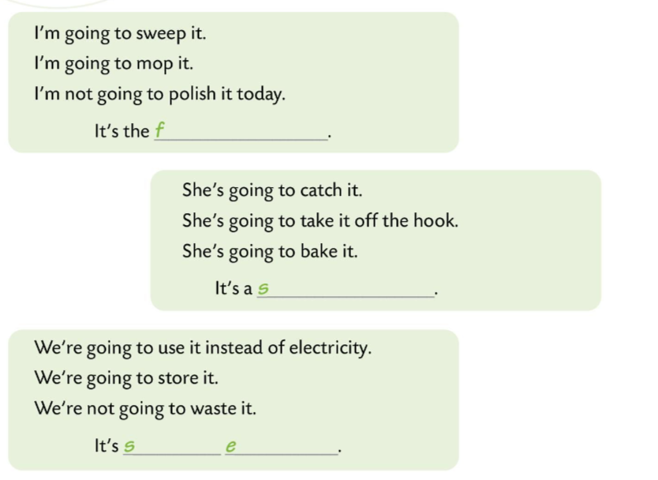
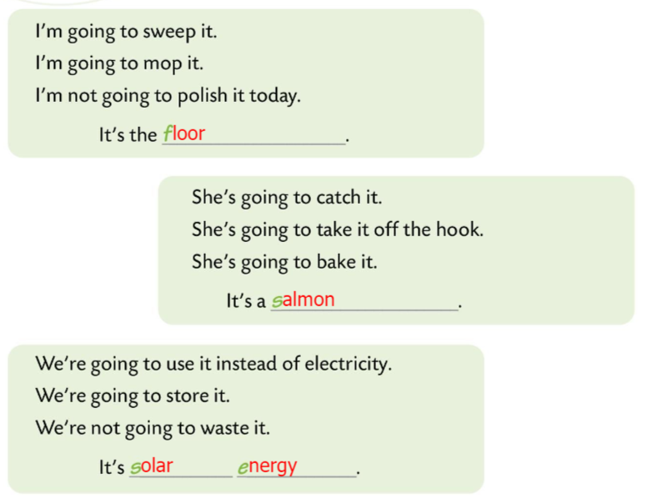
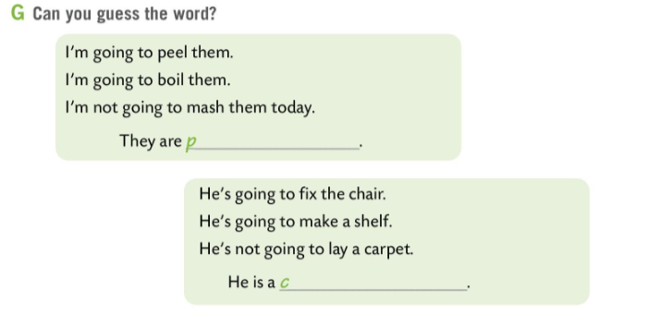
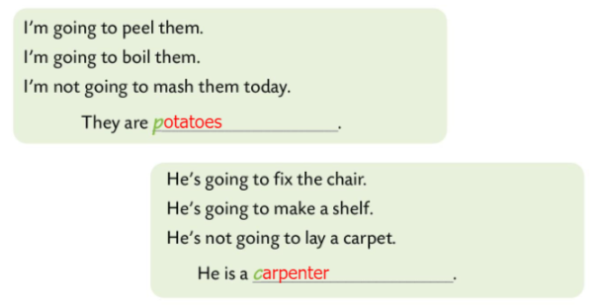
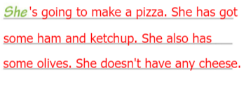

Workbook page 105.
Write what these people are going to make. What have they got at home? What haven’t they got?
Look at the example. Then write sentences in Task F.
Check.
Can you guess the words in Task G (pages 105 and 106).
Check.

Slide 16



Workbook page 106.
Do Task H. Can you write similar sentences ? Go back to the text in the book for some ideas.
Check.

